Slide 1

5 Cyber Stocking Stuffers!
Just a few apps to get you and your community a bit more cyber-secure for the new year

Slide 2

Crypto Caveat
Nothing is 100%
“Feeling too secure makes me feel insecure”
“Never write if you can speak; never speak if you can nod; never nod if you can wink never put it in email” - Eliot Spitzer
Expiration Date: 06/2018

Slide 3

Stocking Stuffer #1: Password Manager
Better Passwords, All in One Place
Pros
You only have to remember one password
Programs can make complex Passwords for you
Better Passwords, harder it is to get hacked!
Things to keep in Mind
Depending on program, can be hard to remember to update passwords
Have to be very careful with your master password
Recommendations (PrivactTools.io)
KeePass/KeePassX
Master Password
Less Pass

Slide 4
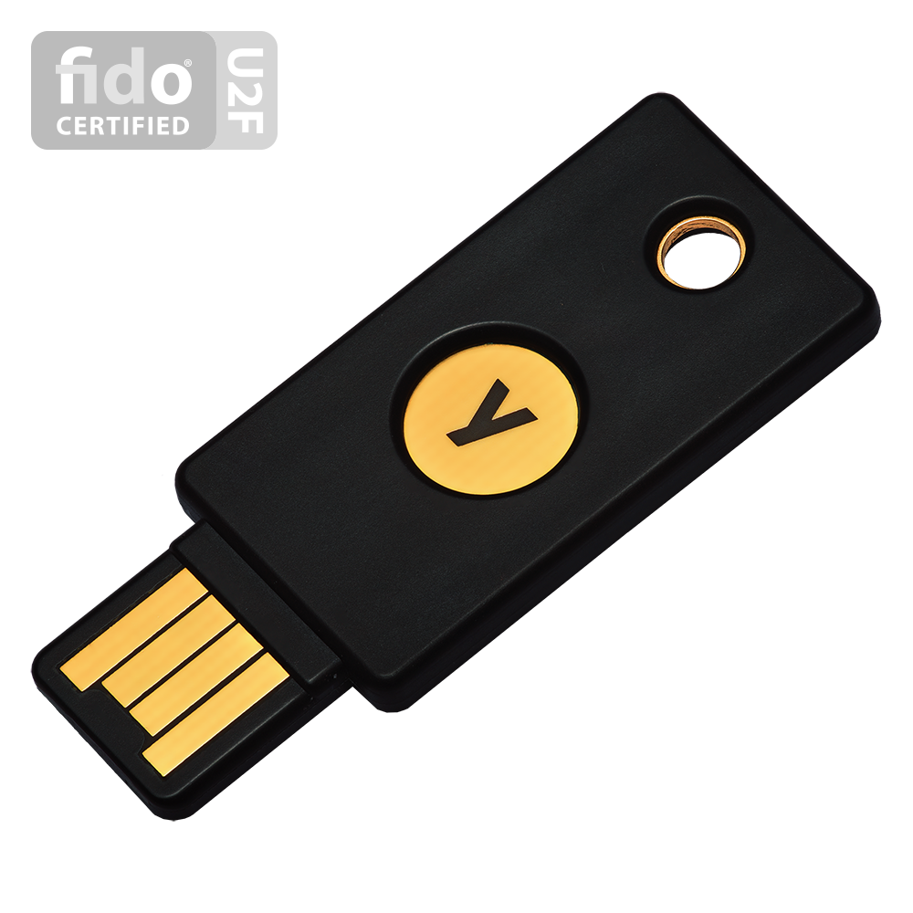
Stocking Stuffer #2: 2FA
Two Factor Authentication
Creates Second-Level of Protection for your accounts!
Methods of 2FA
SMS
Phone Call
Email
Hardware Token (YubiKey)
Software Token (Authy, Free OTP)
2FA Resource
TwoFactorAuth.org

Slide 5


Stocking Stuffer #3: Browser Extentions
Apps developed to make your browsing experience a bit safer
EFF Suite (Firefox/Chrome)
HTTPS Everywhere
Forces website to connect to more Secure (httpS) version of website
Man in The Middle (Snooping)
Transparent Straw vs. Opaque Straw
Does NOT anonymize your browsing experience, just some of the info you upload
Privacy Badger
Stops cross-site Tracking (Green, Yellow, Red System)
Is NOT an Ad Blocker

Slide 6

Stocking Stuffer #4: SIGGNAALLLLLLL
End-to-End Encrypted Texting App
Generates a private key between you and
recipient
Only collects when you installed app and the
day you accessed service
Texting is Open Source
Available for iOS/Android
Can access on desktop
Things to look out for
Voice feature is not Open Source
Not so secure you can write about EVERYTHING
Only as secure as your phone/computer password
Notes:
Whats App vs. Signal
- Whats App metadata: time, date suers
contact list
backs up to cloud
Signal very little meta data
obfuscates phone numbers using crypto hash, discards query
does not back up

Slide 7

Stocking Stuffer #5: Data Detox
8 Day, Day-by-Day Crypto Guide
https://datadetox.myshadow.org/detox
Developed by Tactical Tech and Mozilla
Covers
Searching
Using Google
Social Media
Safe Browsing
Mobile
Phone Apps
Online Ads and You
Making A Plan
Honorable Mention: Crypto Christmas
Notes:
Whats App vs. Signal
- Whats App metadata: time, date suers
contact list
backs up to cloud
Signal very little meta data
obfuscates phone numbers using crypto hash, discards query
does not back up

Slide 8

Recap
Stocking Stuffer #1: Password Manager
KeePass, Master Password, LessPass
Stocking Stuffer #2: 2FA
TwoFactorAuth.org
Stocking Stuffer #3: Extensions
HTTPS Everywhere
Privacy Badger
Stocking Stuffer #4: Signal
Stocking Stuffer #5: Data Detox
https://datadetox.myshadow.org/detox
Notes:
Whats App vs. Signal
- Whats App metadata: time, date suers
contact list
backs up to cloud
Signal very little meta data
obfuscates phone numbers using crypto hash, discards query
does not back up

